Slide 1
Daily Review
Drawing Tabular Dichotomous Keys
Step 1: Label each part of the branched key with a number and a letter, starting at the top and working downwards from left to right.
Step 2: List the characteristics in order, with the number of the next characteristic
Step 3: Name each object as you reach the end of a branch

Slide 2
Daily Review
Drawing Tabular Dichotomous Keys
Step 1: Label each part of the branched key with a number and a letter, starting at the top and working downwards from left to right.
Birds
(duck, emu, chicken, ostrich)
1a
1b
Taller than 1m
(emu, ostrich)
Shorter than 1m
(chicken, duck)
Black and white feathers
Brown feathers
Can swim
Doesn’t swim
Ostrich
Emu
Duck
Chicken
Notes:
Go through rest of numbering using choral responses

Slide 3
Daily Review
Drawing Tabular Dichotomous Keys
Step 2: List the characteristics in order, with the number of the next characteristic
Step 3: Name each object as you reach the end of a branch
Use the numbers and letters to draw a tabular key for this branched key
Birds
(duck, emu, chicken, ostrich)
1a
1b
Taller than 1m
(emu, ostrich)
Shorter than 1m
(chicken, duck)
2a
2b
3a
3b
Black and white feathers
Brown feathers
Can swim
Doesn’t swim
Ostrich
Emu
Duck
Chicken

Slide 4
Drawing Branched and Tabular Keys Practice

Slide 5
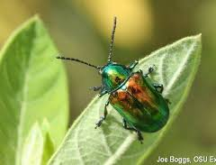
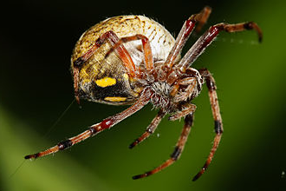
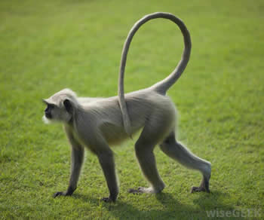
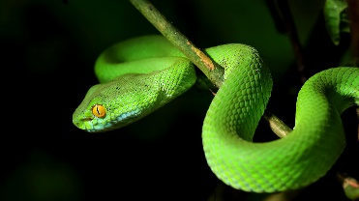
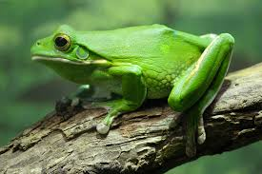
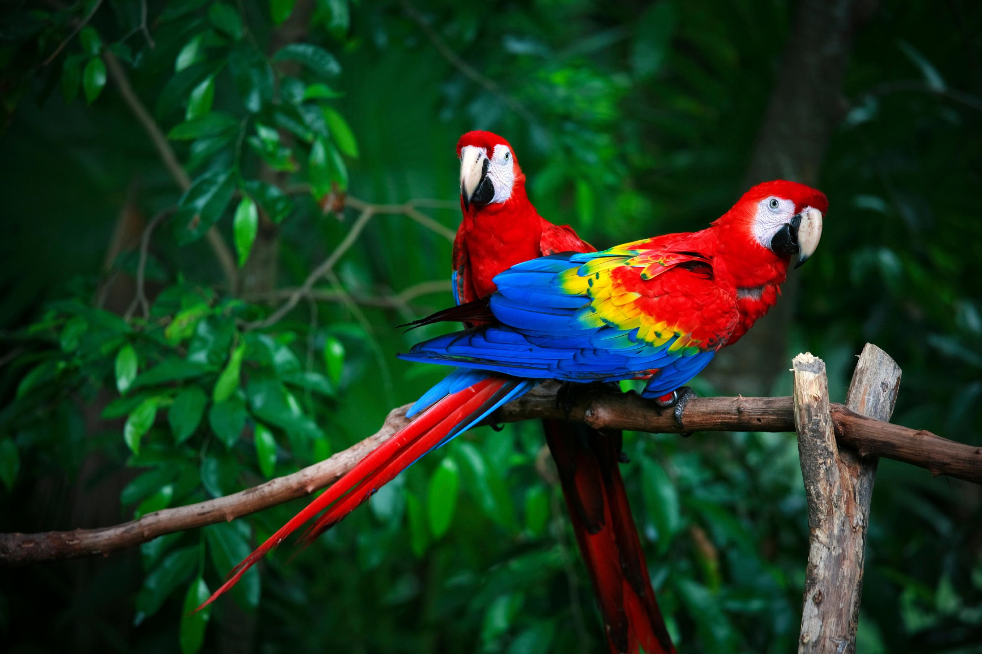
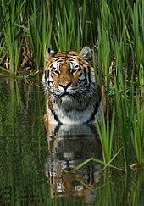
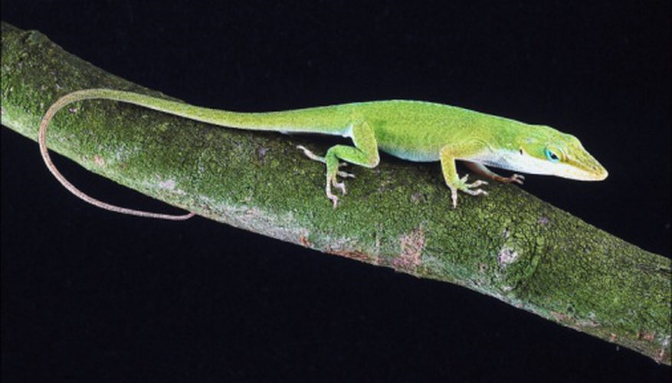
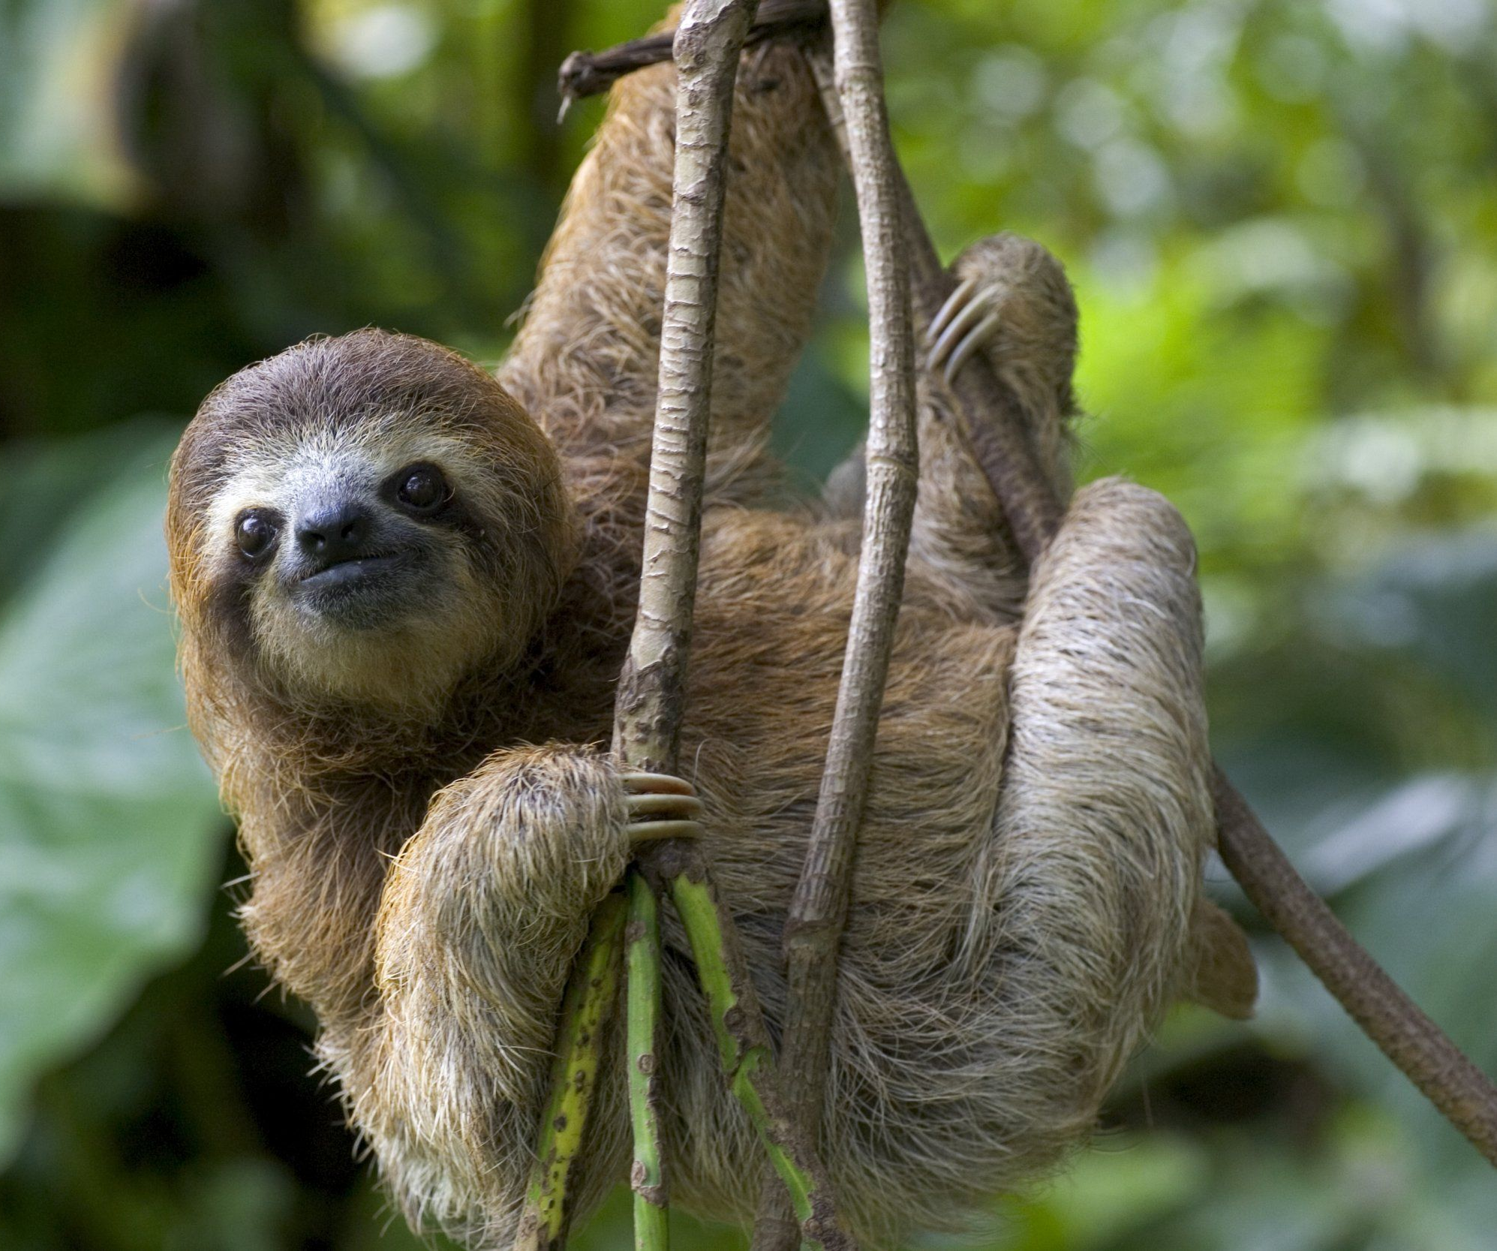
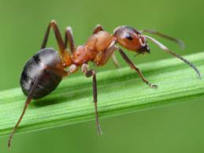
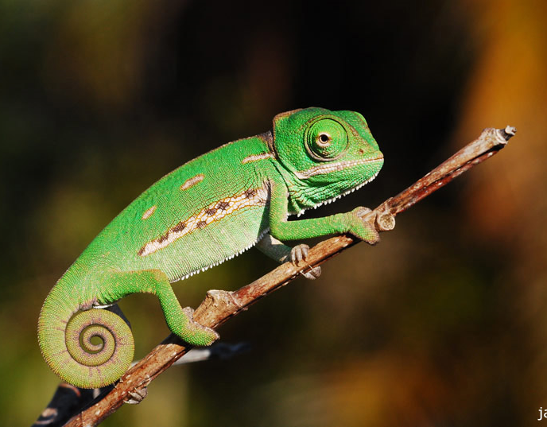
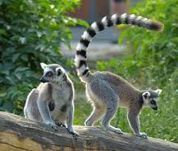
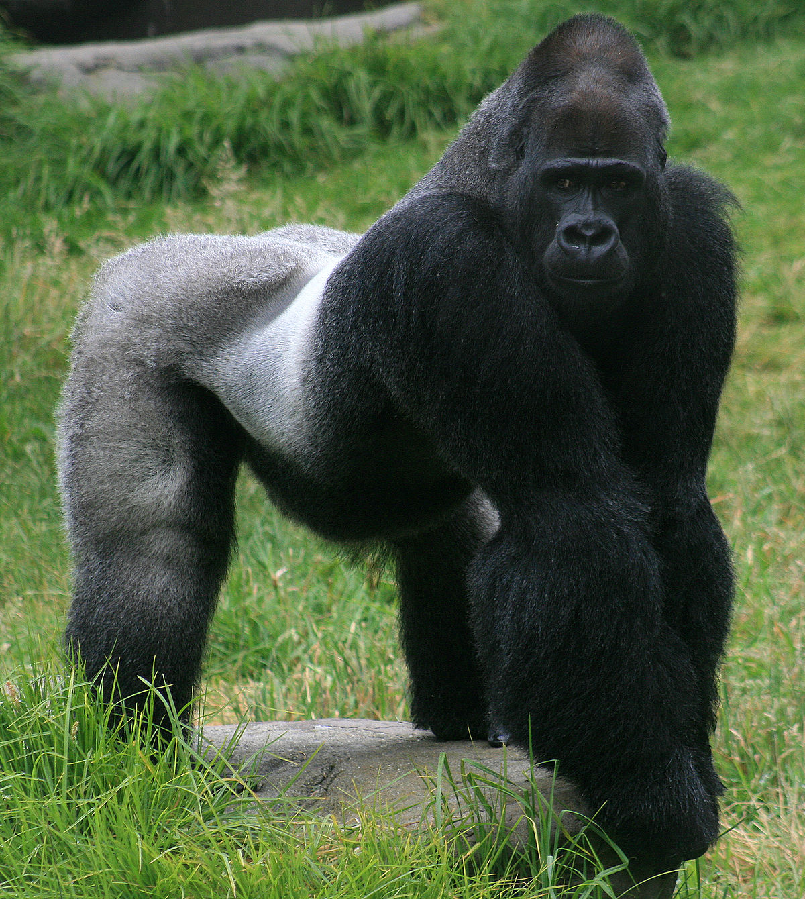
Independent Practice - Draw a branched and a tabular key for each group
Stationery: pencil, paperclip, pen, ruler, eraser, highlighter, stapler, scissors
Sports: baseball, basketball, soccer, tennis, hockey, netball, AFL, badminton, volleyball, swimming
Foods: cheese, tomato, bread, apple, milk, lettuce, carrot, ham, ice cream, chicken, potato, eggs
Jungle animals: monkey, snake, spider, frog, parrot, tiger, sloth, lizard, ant, gorilla, beetle, butterfly, chameleon, lemur
OR collect a set of alien cards

